Slide 1
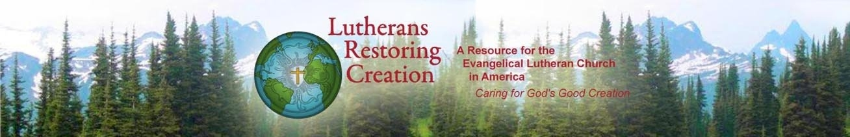
Caring for Creation
A grass roots movement dedicated to care for creation in the ELCA

Slide 2

Who is Lutherans Restoring Creation ?
Founded in 2009, Lutherans Restoring Creation is a grass roots movement devoted to fostering care for creation in the life and mission of the Evangelical Church in America. We work with:
Pastors Lay members
Congregations Synods
Seminaries Colleges
Camps and Retreat Centers Social ministry Organizations
Youth Ministries ELCA agencies of advocacy

Slide 3
Central States Synod LRC Mission Table
June, 2015 - Synod Assembly voted to become a Lutherans Restoring Creation Synod
CSS LRC Mission Table was formed
August, 2015 – Mission Table retreat
Monthly conference calls
February, 2016 – LRC Training Retreat, Camp Tomah Shinga
August 20, 2016 – LRC Training Retreat, Florissant, MO

Slide 4

Statement of commitment
As a congregation, we strive to make care for creation integral to our life and mission—in our mission statement, the decisions we make, the tasks of committees, the worship we celebrate, the maintenance of our property, the programs we embrace, the events we sponsor, our outreach to the community, and our commitment to global issues.
In short, we want care for creation to be part of the ethos and ministry of our congregation.

Slide 5

Action plan
Establish a Green Team to serve as leaven to promote care for creation throughout the life of the congregation.
Spearhead some events, partner with committees for other events, and make proposals for other groups to carry out.
Meet regularly to develop plans and to follow through on projects. Choose from projects suggested or create your own.
Promote the congregation as a creation-care congregation.

Slide 6
Worship
We seek to worship in ways that will express our gratitude and praise to God the creator and that will glorify God intentionally together with all creation. In worship, we will celebrate creation, confess our sins against creation, grieve the losses of creation, commit ourselves to care for Earth, and devote ourselves to peace and justice for humans and for the whole Earth-community.

Slide 7
Worship Action Plan:
Every worship service can include:
Call to worship with all creation.
Confession of sins against creation.
Prayer petition on behalf of creation.
Closing blessing and mission to “Tend the Earth.”
>>> LRC provides creation-care reflections for preachers on weekly lessons.

Slide 8
Worship Action Plan (cont.)
Observe the four-week Season of Creation
Celebrate Earth Sunday
Blessing of the Animals, Rogation Sunday, Tree Planting, Garden Blessing

Slide 9

Education
We seek to learn about the biblical, theological, and ecclesial traditions concerning creation, including the biblical mandate from God for us to care for the earth. We will seek also to learn about the present degradations of creation due to human activity, how these degradations are related to human exploitation and oppression, how we as religious people are implicated in these matters, and what we as Christians can do to heal and restore creation for future generations. We will seek to train people to be leaders in the congregation and the community in our cooperative efforts to care for creation. We will seek opportunities for environmental education for youth of all ages.

Slide 10
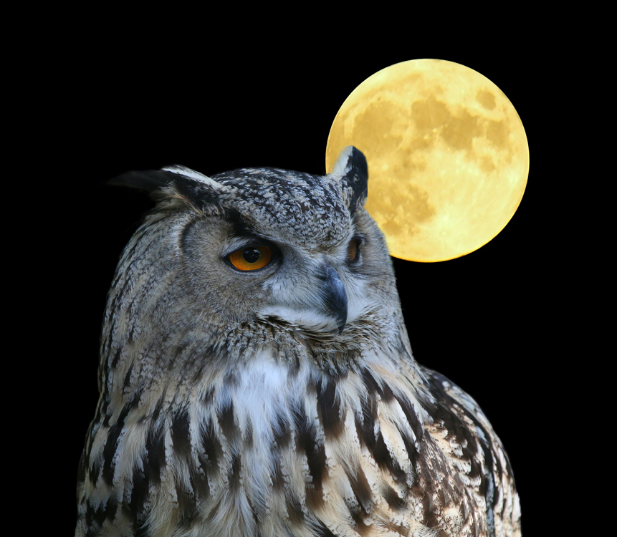
Education Action Plan
Study the ELCA Social Statement “Caring for Creation” with study guide.
Earthbound. A six-week DVD series that explains the theological basis for creation-care with case studies from Lutheran Institutions.
Hold forums, have Bible studies, invite speakers, take a retreat, visit eco-sites of interest to educate members about climate change, pollution, and threats to fresh water.
Vacation church school with nature-friendly theme.

Slide 11
Property
We agree to assess the destructive impact that our activities and the use and maintenance of our property may have upon creation—in such matters as energy use, maintenance products, paper use, water use, recycling, waste, transportation, land use, among others. We will strive to make choices that lessen our negative impact on the earth and that serve to heal and renew Earth community.

Slide 12
Property Action Plan
Do a comprehensive environmental audit: energy, lawn care, recycling, paper, water, cleaning products, transportation, and more. Take actions.
Energy Stewards Initiative. LRC sponsored one to two year program to reduce energy and lower carbon footprint.
Experience your property as an Earth community.

Slide 13

Personal Discipleship
We encourage each other as individual members of this congregation—at whatever age, economic level, ethnic group, or walk of life—to care for creation in our personal lifestyle, in our homes, and at our work, knowing that our habits and practices can contribute significantly to restore creation. We seek to foster a closer relationship with nature so that we can live simply and walk lightly upon the earth.

Slide 14

Discipleship Action Plan
Invite members to make an LRC “Covenant with Creation” to affirm their commitment.
Train members to do an environmental audit of their homes and take action.
Suggest and provide materials for daily devotions and inspiration.
Establish eco-book club or group to watch eco-videos.
Take a retreat to cultivate relationship with the rest of nature.

Slide 15

Public Ministry/Political Advocacy
We seek to change the cultural patterns and systems of government, business, industry, and other institutions that foster the degradation of creation and to rectify the injustices against Earth community that result against from them. We seek to alert our members to environmental legislation that protects creation and to encourage their active participation in the development of public policy. We encourage members to participate in civic activities and organizations that foster environmental health. We seek to let our care for creation become a witness to others.

Slide 16
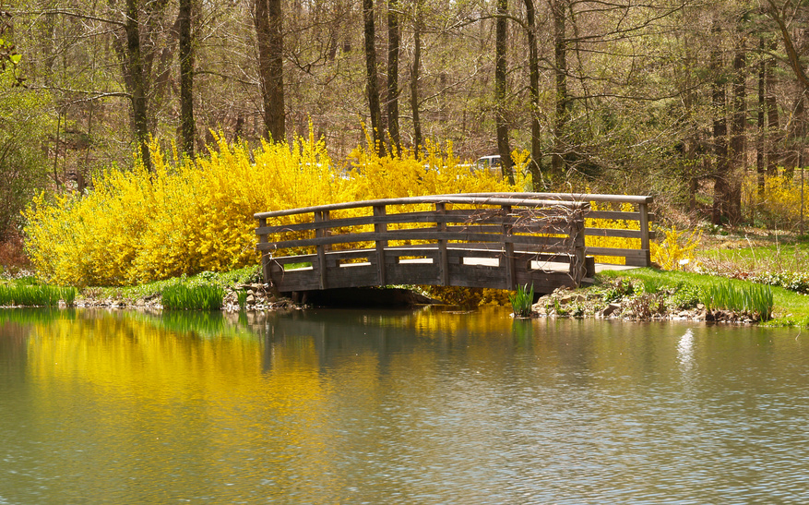
Public Ministry Action Plan
Restore nature. Clean up a river, restore a prairie, establish a community garden.
Join ELCA advocacy action alerts to promote earth-friendly laws and policies.
Start a local Green Congregations program to meet regularly and encourage each other in creation-care.
Promote Community Supported Agriculture and food choices by members that are healthy for people and environment.

Slide 17
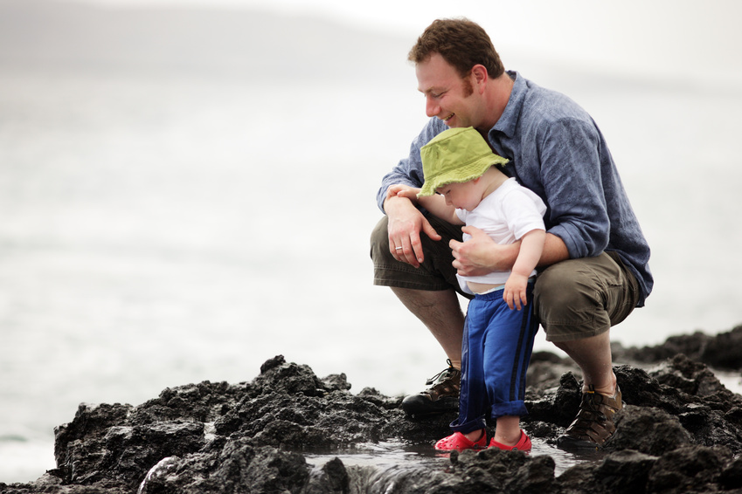
Out of Love
We will explore the implications of these provisions together in a grace-filled and non-legalistic way, seeking to find hope and joy in the commitments that these provisions may entail and in the restorations that they engender. Because we desire to leave Earth a better place for our children and grandchildren, we will promote love and respect for creation in our youth, teach them responsible Earth practices, and engage them in programs that restore creation.

Slide 18
CSS Lutherans Restoring Creation Mission Table
We stand ready to support you in your efforts to be
Earth-keepers in your congregations, communities,
and personal lives at home and work.
Attend our LRC Workshop, August 20, Florissant, MO
Visit www.lutheransrestoringcreation.org
Take our congregational survey at www.css-elca.org/lrc
Invite an LRC Mission Table trainer to lead a workshop in your congregation
Contact: Noni Strand nonistrand@gmail.com
Gary Anderson gjanderson1963@gmail.com
Jan Koch njkoch@aol.com
Jane Meyerkord jmeyerkord@aol.com
Join the Mission Table!

Slide 19
Survey Says….
16 congregations responded to the survey
81% recycle some items 50% provided education in creation care
75% paper
63% plastics 31% are using less pesticides/herbicides
63% aluminum
81% have cut energy use by various means
81% increased use of reusable dinnerware vs. plastic/Styrofoam
25% have a green team
25% are composting 19% have a community garden

Slide 20
WHAT ARE CONGREGATIONS IN CENTRAL STATES SYNOD
DOING TO CARE FOR CREATION?
The Bridge Market and Faith Community, St. Charles, MO
“Urban Stitchers” group crochets mats made out of recycled plastic bags for unsheltered individuals
Formed a “Bridging Hunger Project” that planted and harvested hardy vegetables in an organic farm that rents plots. Vegetables were given to a pantry in a food desert area of St. Louis
Children’s Memorial Lutheran, Kansas City, MO
Cut energy use by not heating/cooling entire building
Worship in gathering space vs. sanctuary
Increase use of reusable dinner ware
Gethsemane Lutheran, St. Louis, MO
New HVAC system
Education in creation care

Slide 21
Christ and Trinity Lutheran Church, Sedalia, MO
Have installed a 12 kilowatt solar energy system, estimated to produce 15,000 kilowatt hours of solar electricity annually. In terms of environmental equivalencies, offsetting 23,332 pounds of CO2 is like eliminating the emissions caused by burning 1,186 gallons of gas each year or by planting 271 tree seedlings, grown for 10 years
First Lutheran, Manhattan, KS
Provide leadership for Dialog on Sustainability and Kansas Natural Resource Council (KNRX)
Recycling
Cut energy use by using LED lights outside
Studying the Pope’s Encyclical
Holy Cross, Overland Park, KS
Cut energy use, sensor lights, temp augmentation, Energy Star rated machines
Full facility audit including ABC/IMFA/LEED options as part of renovation plan
Understanding, preaching and teaching on stewardship and dominion as life style

Slide 22
Hillside Community, Spring Hill, KS
Attic insulation—batt added by volunteers and professional insulation blown in. Projected payback in 2 years.
Kent Memorial, Sunrise Beach, MO
Replaced 3 furnaces with energy efficient units
Tinted some windows and added curtains to others, making those rooms easier to cool in summer
Replacing incandescent light bulbs with CFL or LED
Lutheran Church of the Atonement, Florissant, MO
Community Garden using organic methods and planting natives for birds/butterflies
Earthbound DVD series in Adult Forum
Members and confirmation youth are crocheting mats for the homeless from grocery bags
Tips about care of creation in monthly newsletter and partnering with Missouri Interfaith Power and Light to show “Chasing Ice” movie

Slide 23
Lutheran Church of the Resurrection, Prairie Village, KS
Cut energy usage—low flow toilets, motions sensor lights, energy efficient HVAC system, lighting and programmable thermostats
Preaching on environment stewardship
Earth Sunday Celebration—each family received a flowering plant and table card with scripture and prayer for creation care and we planted apple trees to start a grove to provide fresh fruit for weekly free breakfasts
Monthly newsletter articles with information on recycling medications, e-waste , hazardous waste, plastics, pesticide use
Our Redeemer Lutheran Church, Ness City, KS
Cut energy use by programmable heat/AC unit
As a farming community, our efforts and commitments are to preserve and protect our earth
Overland Park Lutheran Church, Overland Park, KS
Programmable thermostats
Abiti paper recycling receptacle on premises

Slide 24
Peace, Joplin, MO
Met with Conservation Department and Audubon representatives to evaluate our 12 acres of savannah on our property to learn about restoring the natural setting
Conservation efforts on property include rain garden, butterfly garden, bat houses, bird houses, native plantings, tree plantings. Applied for grant funds to help develop butterfly and rain garden
Planted native raspberries, blackberries, persimmons as well as peach and apple trees
Developed walking trail and invited community to use the trail
Shepherd of the Hills, Bridgeton, MO
Programmable thermostats
Peg board with ceramic coffee mugs
Plastic or ceramic bowls, metal flatware used for soup suppers
“Garden of Eatin” community garden
Zion, Ferguson, MO
Signs concerning energy usage/lights
Replacing lights in meeting rooms, recycling old ones

Slide 25
St. John, Russell, KS
Soles-4-Soles—take van loads of shoes to a Wichita collection site
Green Rewards program—individuals throw their name in a hat for some “green” activity they have done, draw a name each month and award a “green” gift
Recycle cell phones for soldiers, greeting cards, and batteries

