Slide 1
2018 Synod Assembly
Update from the
ELCA Churchwide Organization
Notes:
In your opening remarks be personal, share a bit of who you are. Briefly make a connection between your role as a Churchwide representative to the synod assembly and your own faith story/journey.

Slide 2
Thank you
For your warm welcome and hospitality
Glad to see long-standing friends and to add new ones
Let’s hear a greeting from our Presiding Bishop Elizabeth Eaton.

Slide 3
Greetings
From your colleagues in the Churchwide Offices of the ELCA.
I serve you as Director for Congregational Vitality
I work closely with your Directors for Evangelical Mission, Rev.Donna Simon and Rev. Susan Candea. They are: directors of “missional traffic”, “midwives” for innovative work, “scouts” for missional leaders, and “metamucil” for the status quo in the Synod.

Slide 4
Presiding Bishop Elizabeth Eaton’s four strategic statements of emphasis:
We are church
We are Lutheran
We are church together
We are church for the sake
of the world.

Slide 5


Slide 6
Future Directions 2025, approved by Church Council, reflects what people across this church said was important. The goals are:
1
A thriving church spreading the gospel and deepening faith for all people
2
A church equipping people for their baptismal vocations in the world and this church
3
An inviting and welcoming church that reflects and embraces the diversity of our communities and the gifts and opportunities that diversity brings
4
A visible church deeply committed to working ecumenically and with other people of faith for justice, peace and reconciliation in communities and around the world
5
A well-governed, connected and sustainable church

Slide 7
The Conference of Bishops, Church Council and Churchwide Organization have all affirmed two main focus areas for the next few years.
Congregational Vitality
Leadership
Learn more: ELCA.org/future

Slide 8
Congregational Vitality
A “description” is better than “definition”
Descriptions are contextual.
“Communities of Jesus that nurture life changing relationships with God, one another and the world”

Slide 9
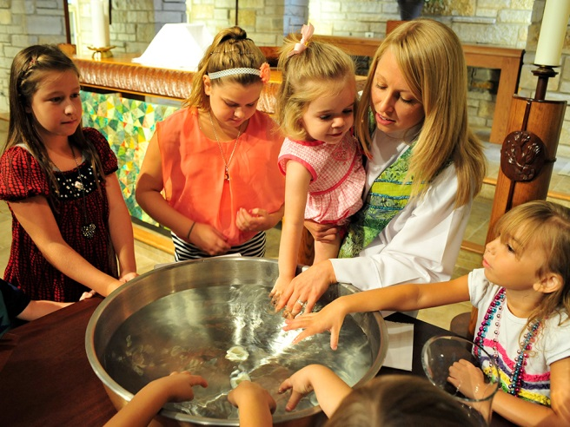
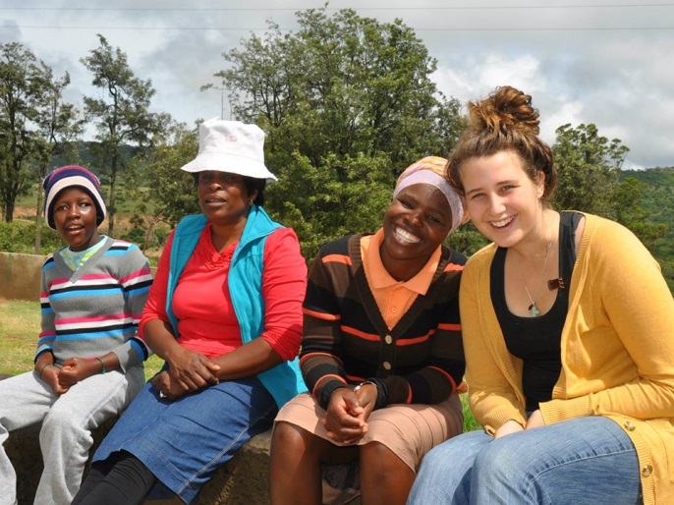
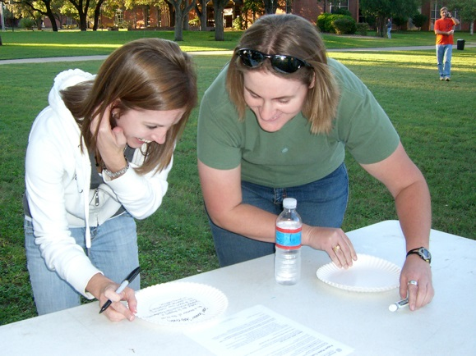
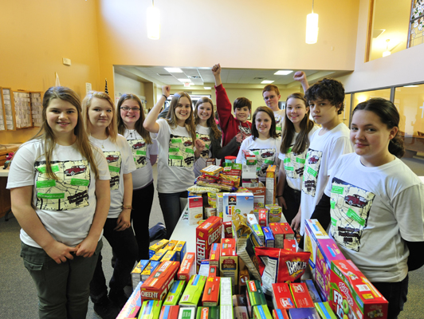
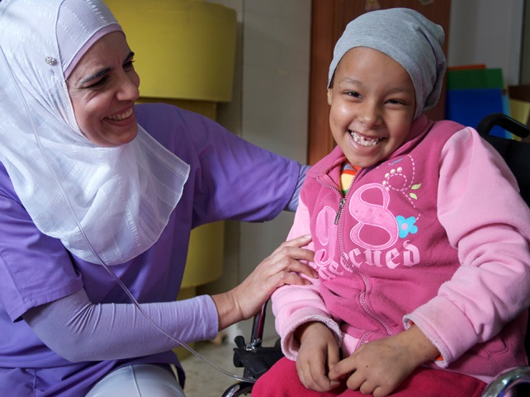

Thank you!
Notes:
Thank you!
Through your generous Mission Support and other giving, together we are able to:
Make vital, life-changing ministries happen across this country and overseas
Train leaders who’ve become missionaries, advocates and pastors
Break the systems that foster hunger and poverty
Join with partners and companions worldwide to pray and work for peace

Slide 10
Thank You
The your active support of the ELCA World Hunger. In 2017, Lutherans gave $21.3 million; with $454,000 coming from your Synod.
The Metropolitan Lutheran Ministry in Missouri received a Domestic Hunger grant to support their service to neighbors in Jackson County. Last year they harvested 2,200 pounds of fruits and vegetables to share.
Thank you for this important ministry.

Slide 11
Thank you
For your ministry of accompaniment with the ELC of Papua New Guinea and the ELC in Urals, Siberia and the Far East.
For your partnership with the Mission Investment Fund, investing 10.3 million and receiving 7.5 million in loans.
For investing in New Starts: 9+1

Slide 12
Central States New Starts
1. Gathering Table, Kansas City
2. Sagrado Corazon, Garden City
3. K C Eastside, Kansas City
4. Oromo Mission, Kansas City
5. Laotian Community, Olathe
6. Parroquia El Divino Nino, Garden City
7. Partners Ministry, Wichita
8. South Sudanese, Saint Joseph
9. The Bridge, Saint Charles
10. The Listening Post, Prairie Village

Slide 13
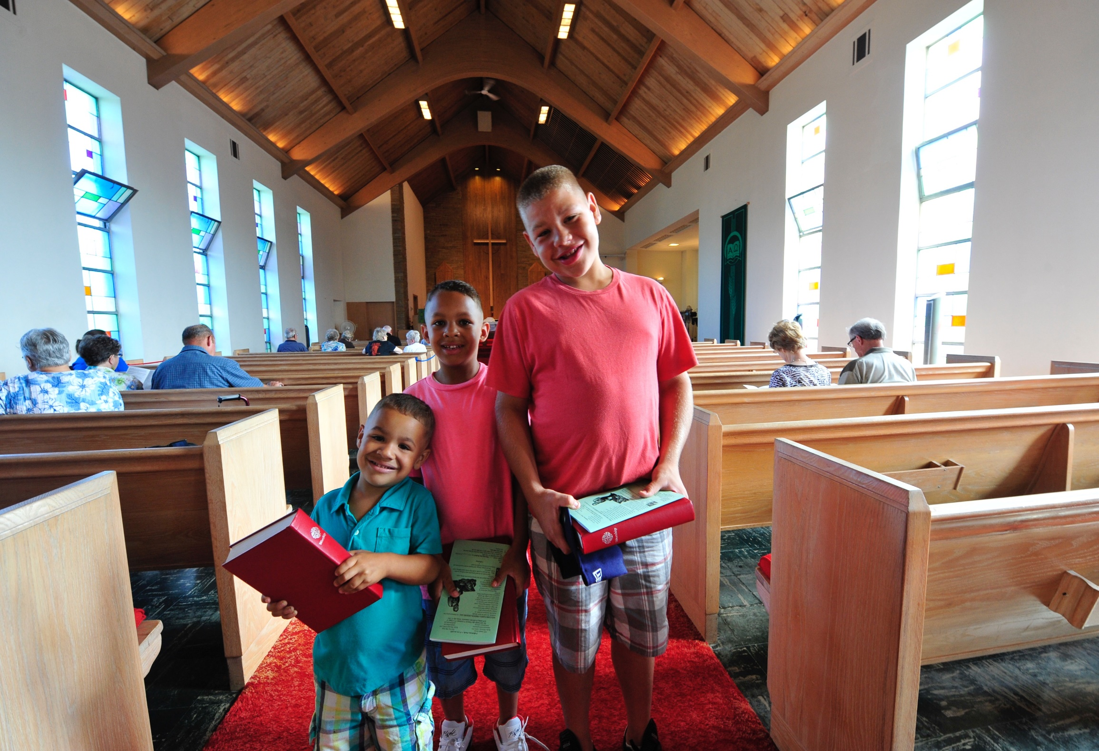
Thank You
for Mission Support: 50%

Slide 14
A word of Appreciation
For the leadership of Bishop Roger Gustafson.
Serving among you.
Serving through the Conference of Bishops.
-Synodical and Rostered Leaders Care Cte.
-Immigration Ready Bench
For the Synod staff, who support the leadership and ministry in your congregations.

Slide 15

Connected Expressions

Slide 16
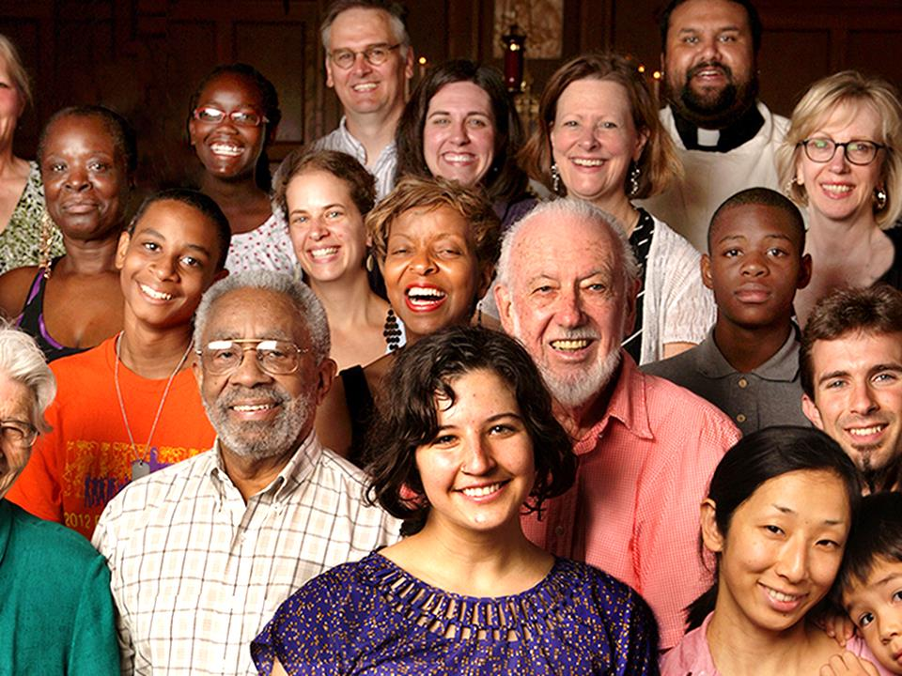
9,300 places
3.7 million people

Slide 17

512 organized congregations
401 new starts at work now in very diverse settings
Notes:
Can we add a slide right after this one with a similar treatment that says “Accompanied 80 companion churches around the world”
I’

Slide 18
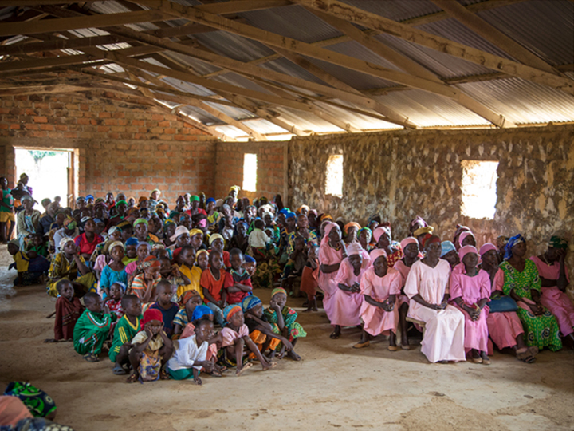
Accompany 80 companion churches around the world

Slide 19
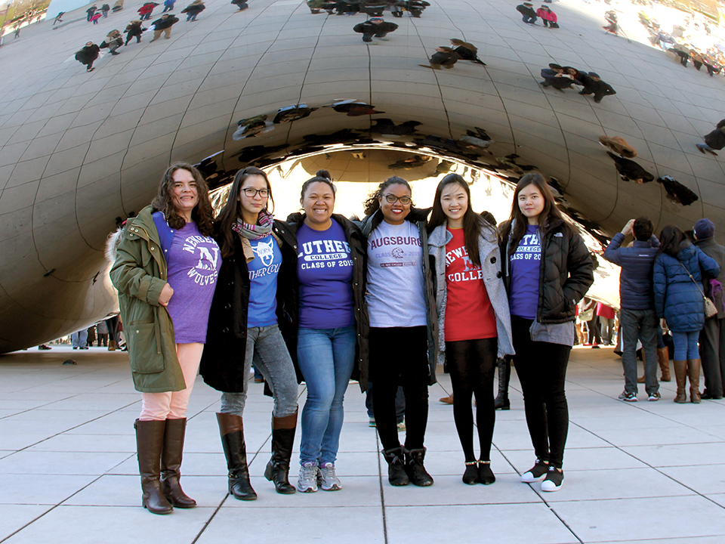
Global Church Sponsorship invites support for Missionaries, Young Adults in Global Mission, International Women Leaders and Global Ministry projects.

Slide 20
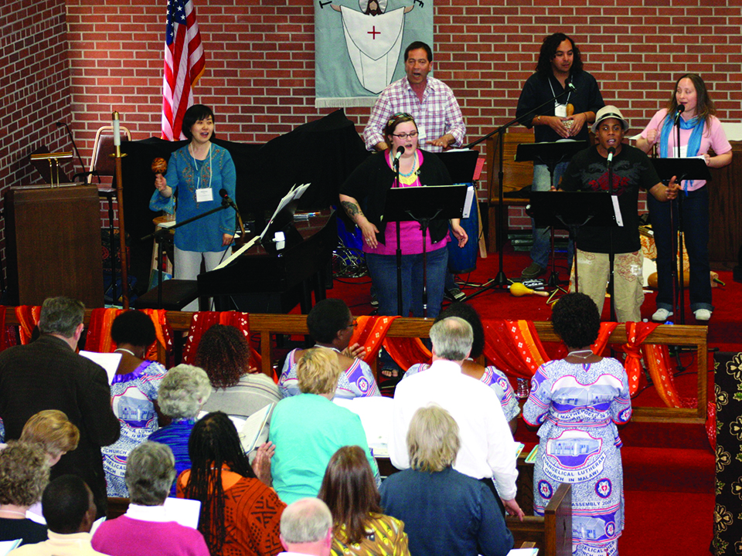
Receive the global church’s diverse gifts to build the ELCA’s capacity to proclaim and serve

Slide 21

Theological Discernment
Women and Justice Social Statement Process
Draft ready!
Your feedback is needed!
ELCA.org/womenandjustice

Slide 22

$144 million out of the $198 million goal. $1.1 million from your Synod in last 2 years.

Slide 23
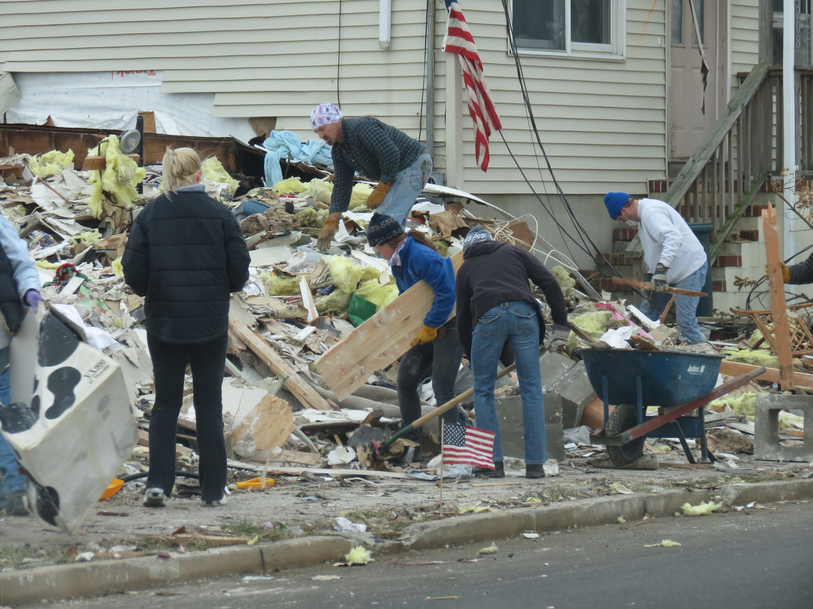
Lutheran Disaster Response received $22.8 MILLION in 2017. $429,000 from this Synod. Responding in 15 states, bringing hope and healing among those rebuilding lives after disasters

Slide 24
“God’s work. Our hands.” Sunday
Sept. 9, 2018
6th year.
We all acknowledge that ELCA members work every day to share God’s love. This day is our opportunity to do this work together!
Identify service projects that make sense for your congregation’s situation.
Visit www.ELCA.org/dayofservice to download a toolkit and register your congregation.

Slide 25
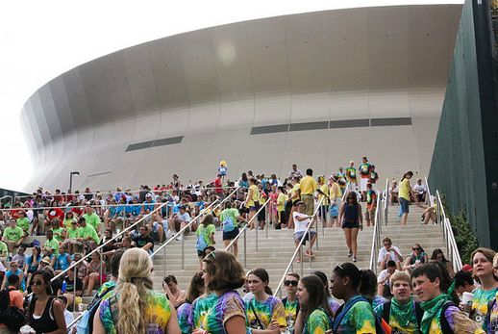
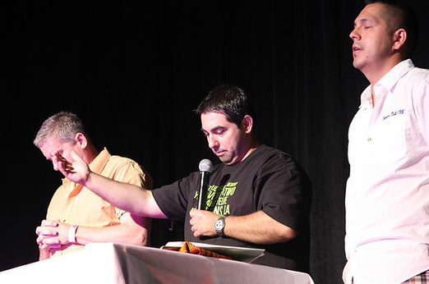
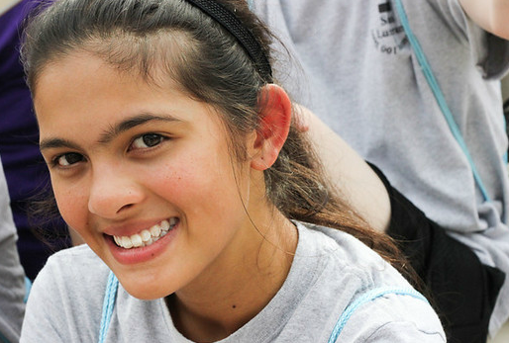
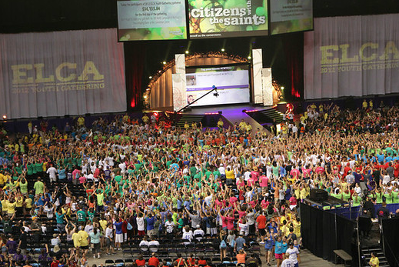
2018-Youth Gathering- 30,000

Slide 26


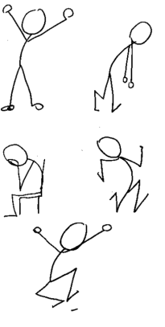
God at Work
Other churches & faith communities
Public Spaces
God’s Mission
Associations
Institutions
People

Slide 27
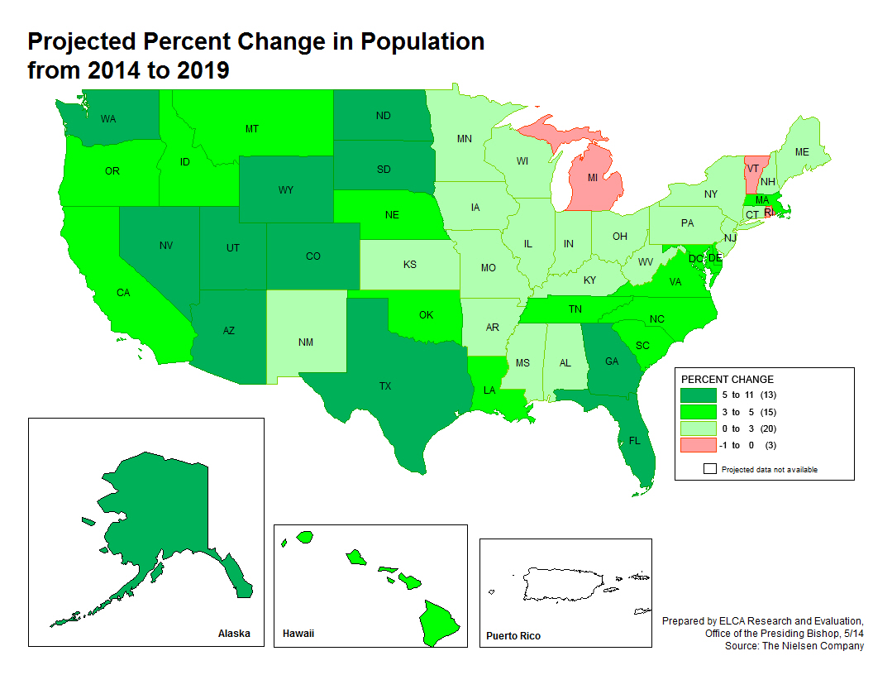


Slide 28
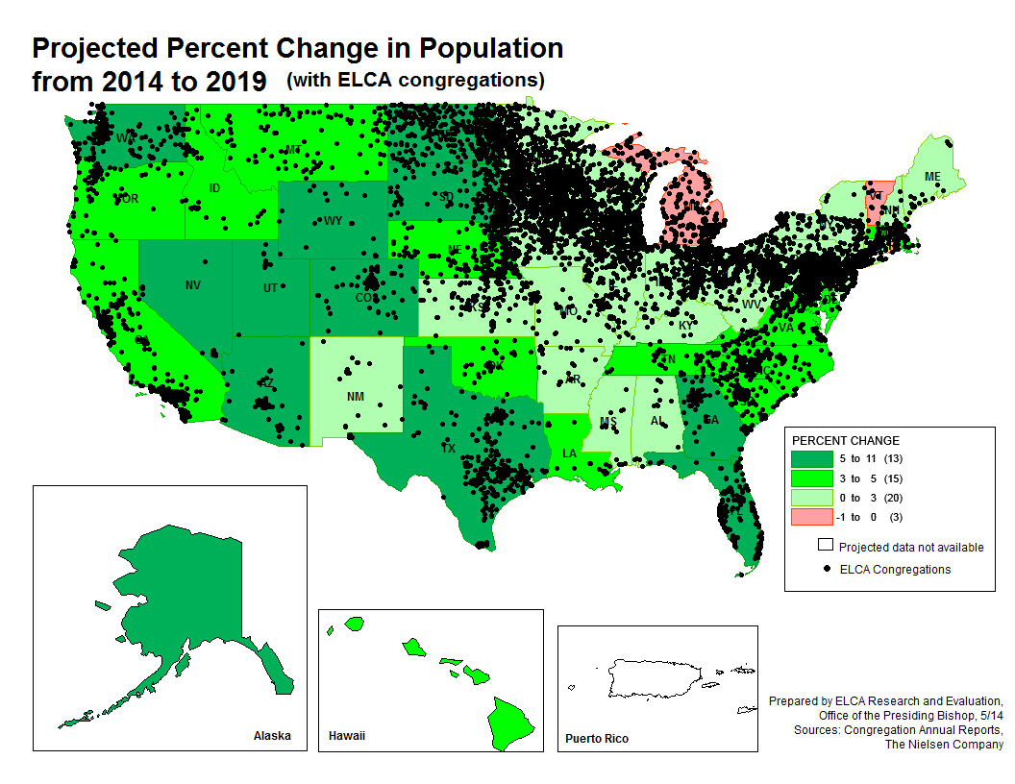

Slide 29
GRAYING OF OUR CONGREGATIONS

Slide 30

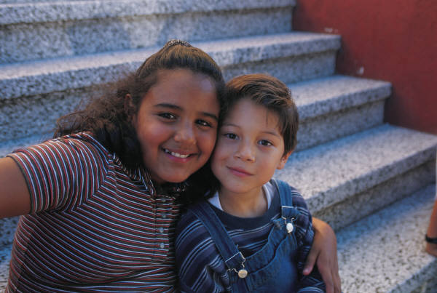

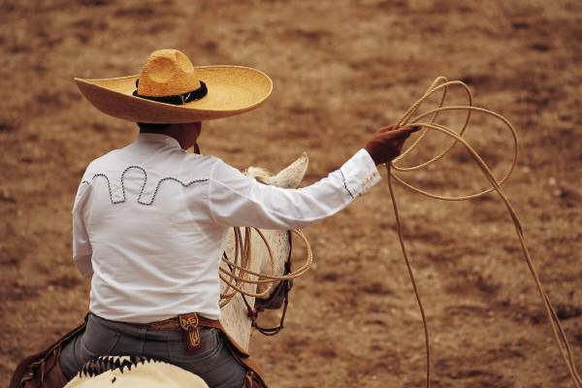
New Faces in our midst

Slide 31
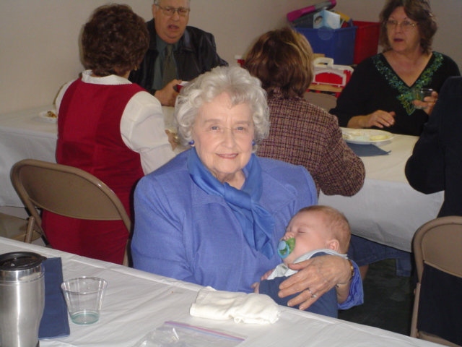
OUR STRENGTHS

Slide 32

Rich & Deep Theological Heritage

Slide 33

ELCA500.org
Notes:
Observance of the 500th anniversary of the Reformation is well underway. This January, travel expert Rick Steves provided a copy of his new Reformation documentary to every ELCA congregation. Reformation storytelling is emphasized in Living Lutheran and other ELCA publications, and congregational resources and a comprehensive events calendar are available at ELCA500.org.

Slide 34
Lucas Cranach’s Altarpiece
At St Mary’s Church in Wittenberg
Where Martin Luther was Pastor
Look at details
The next 500 years, God’s story and God’s people out in the public.

Slide 35
ELCA is changing
Before: Called, gathered and nourished
Today: Claimed, gathered and sent.
Out into God’s world, listening, learning, exploring, serving, being welcomed and witnessing to God’s real presence in our neighborhoods .

Slide 36
TRUST THE PROMISES
Jesus: …”I will build my Church…”
Jesus: …”I will be with you always…”
Jesus:…..”I am making all things new”
God, through Isaiah: …”My word will never come back empty, but will always accomplish the purpose for which it is sent”.

